Slide 1


ASK MATE
III
A CodeCool project

Slide 2



AGENDA
8. Future plans
7. Challenges
6. Demo
9. Q&A session
5. New Features
4. Task distribution
3. Sprint timeline
2. Used technologies
1. Project team

Slide 3




PROJECT TEAM
Marcin Szkurłat
Marcin
Stodolny
Tomek
Citko

Slide 4













USED TECHNOLOGIES

Slide 5

MONDAY
TUESDAY
WEDNESDAY
THURSDAY
FRIDAY
SPRINT TIMELINE
Merging previous sprint
User registration
User login
List users
Adding comments to questions
Searching questions
Editing answers
Bind questions to user
Bind answer to user
Bind the comment to user
User page
Accepted answer
Security issues fixing
Gain reputation
Lose reputation
Filter bonus questions
Sort bonus questions
Optional: change font
Optional: CSS
Code cleaning
Final presentation

Slide 6
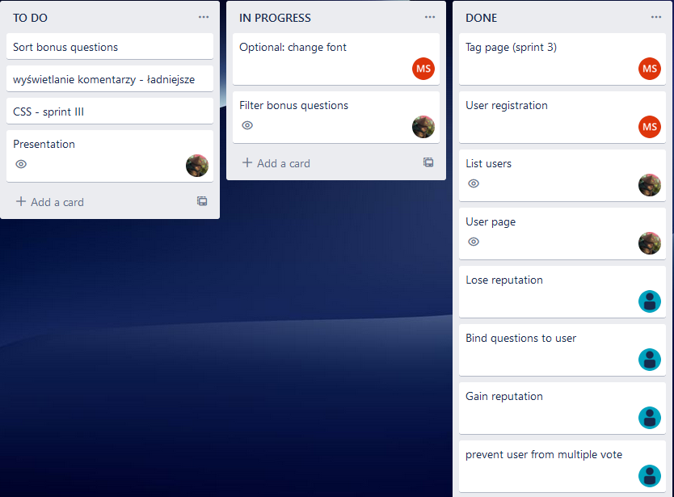

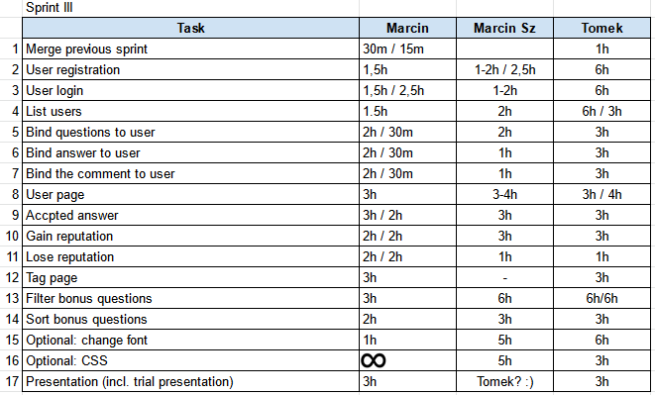
TASK DISTRIBUTION

Slide 7
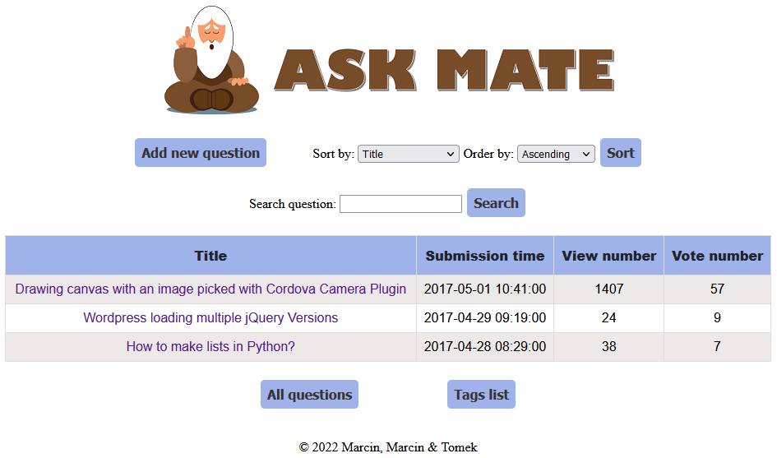

Web app features
Anyone can add questions.
Anyone can answer.
Each question and each answer can be upvoted or downvoted.
Each contribution expands database of wisdom.
Each vote helps others to find the best answer.
Adding images.
WWW.ASKMATE.CC

Slide 8
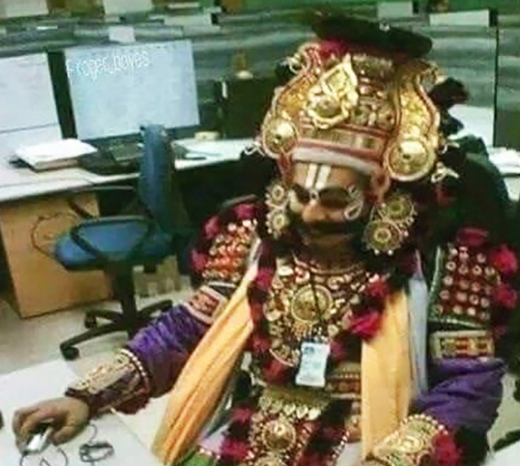
NEW FEATURES (Sprint II)
SQL database implemented (impoved scalability and flexibility)
Search function
Added comments
Added tags
More editing and deleting options
Only SQL
my fren

Slide 9





NEW FEATURES (Sprint III)
Added user registration/login
Questions/answers are now binded to the users
Users have detailed profile page
Question owner can accept the most helpful answer
Bonus JS content for entitled users
More secured database
Implemented reputation system

Slide 10
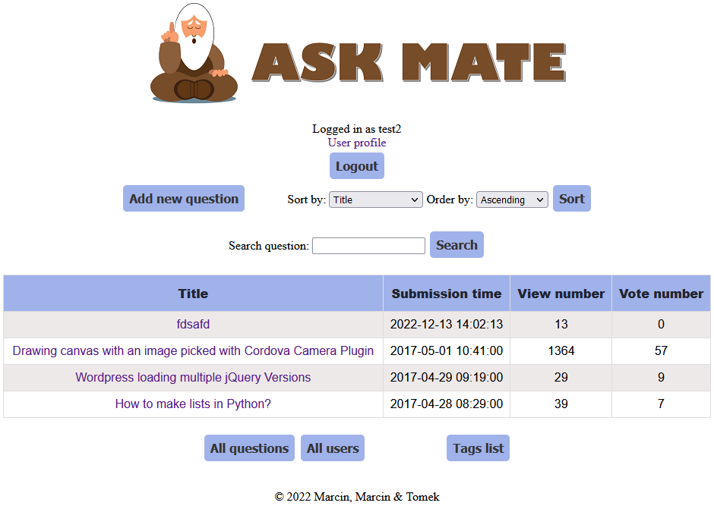
DEMO
ENJOY!

Slide 11

@app.route("/")
@app.route("/list")
def hello():
all_questions = data_manager.get_all_data_from_file("questions.csv")[::-1]
for item in all_questions:
date = datetime.date.fromtimestamp(int(item[2]))
item[2] = f"{date.day}-{date.month}-{date.year}"
return render_template('index.html', all_questions=all_questions, QUESTION_HEADER=QUESTION_HEADER)
@app.route("/question/<question_id>")
def display_question(question_id):
questions = data_manager.get_all_data_from_file("questions.csv")
current_question = questions[int(question_id)-1]
questions[int(question_id)-1][HEADERS_INDEX["view number"]] = int(questions[int(question_id)-1][HEADERS_INDEX["view number"]]) + 1
data_manager.write_file("questions.csv", questions)
duration = int(time.time() - int(current_question[HEADERS_INDEX["submission time"]]))
return render_template('question.html', question=current_question[1:], time=str(datetime.timedelta(seconds=duration)), question_id=question_id)
@app.route("/add_question", methods=['GET', 'POST'])
def add_question():
all_questions = data_manager.get_all_data_from_file("questions.csv")
new_question = ["" for _ in range(7)]
if request.method == 'POST':
new_question[HEADERS_INDEX["id"]] = len(all_questions) + 1
new_question[HEADERS_INDEX["title"]] = request.form['title']
new_question[HEADERS_INDEX["submission time"]] = int(time.time())
new_question[HEADERS_INDEX["view number"]] = 0
new_question[HEADERS_INDEX["vote number"]] = 0
new_question[HEADERS_INDEX["message"]] = request.form['message']
data_manager.write_file("questions.csv", all_questions, new_question)
if request.files:
img = request.files["file"]
way = (os.path.abspath("static\\upload\\"))
img.save(f"{way}\\test.jpg")
return redirect(f"/question/{new_question[0]}")
return render_template('add_question.html',
title="Add question")
@app.route("/question/<question_id>/edit", methods=['GET', 'POST'])
def edit_question(question_id):
id_index = int(question_id) - 1
all_questions = data_manager.get_all_data_from_file("questions.csv")
edited_question = list(all_questions[id_index])
if request.method == 'POST':
edited_question[HEADERS_INDEX['title']] = request.form['title']
edited_question[HEADERS_INDEX['message']] = request.form['message']
all_questions.pop(id_index)
all_questions.insert(id_index, edited_question)
data_manager.write_file("questions.csv", all_questions)
return redirect(f"/question/{question_id}")
return render_template('edit_question.html',
title="Edit question",
question_id=question_id,
question_title=edited_question[HEADERS_INDEX['title']],
question_message=edited_question[HEADERS_INDEX['message']])
@app.route("/question/<question_id>/delete", methods=['GET', 'POST'])
def delete_question(question_id):
id_index = int(question_id) - 1
all_questions = data_manager.get_all_data_from_file("questions.csv")
if request.method == 'POST':
all_questions.pop(id_index)
data_manager.write_file("questions.csv", all_questions)
return redirect('/')
@app.route("/votes", methods=["POST"])
def up_vote():
all_questions = data_manager.get_all_data_from_file("questions.csv")
index = None
if request.method == "POST":
if request.form.get("vote_up"):
index = int(request.form.get("vote_up")) - 1
all_questions[index][HEADERS_INDEX["vote number"]] = int(all_questions[index][HEADERS_INDEX["vote number"]]) + 1
elif request.form.get("vote_down"):
index = int(request.form.get("vote_down")) - 1
all_questions[index][HEADERS_INDEX["vote number"]] = int(all_questions[index][HEADERS_INDEX["vote number"]]) - 1
data_manager.write_file("questions.csv", all_questions)
return redirect(f"/question/{index + 1}")
CHALLENGES
Using JavaScript for the first time
SQL injection prevention
XSS-securing page

Slide 12
Future plans
Integrate web app with other platforms (facebook, twitter etc.)
Add options to organize webinars related to most searched questions.
Build AI interface to immediately answer any question (mark this answer as „AI generated”)
AI integration
help plz

Slide 13

ANY
QUESTIONS?

Slide 14
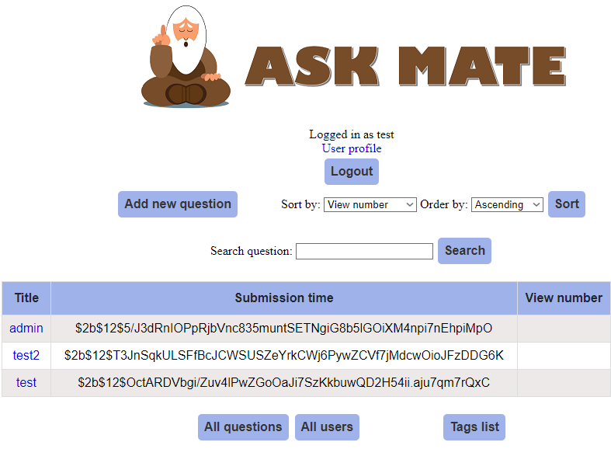
http://127.0.0.1:60000/list?sort_by=view_number&order_by=DESC;SELECT username as title, password as submission_time FROM users;

